Slide 1
Presentation for RRM1
on
A Mining Frame work for Efficient Fault Detection and Diagnosis using Heterogeneous Graph based D-Matrices
By Under the Esteemed Guidance of
P.VASANTH SENA Dr P.SAMMULAL
H.T.No: 1503PH0645 Assoc Professor & NSS Coordinator,
Research Scholar (Ph.D in CSE) CSE Department,
R & D Cell, JNTUH Hyderabad JNTUCEH, Hyderabad.
vasanthmtechsit521@gmail.com
12/21/2018
RRM1

Slide 2
AGENDA
Introduction
Scope of the Problem
Context of Research Problem
Related Work
Research Agenda
Algorithms Studied
Intermediate Results
Conclusion
References
12/21/2018
RRM1

Slide 3
Introduction:
D-Matrix: It is the principle information model is used for performing diagnostic inference for multiple failure modes both in static as well as dynamic system.
Convolutional Neural network: A convolutional neural network is a class of deep learning, We used to analyzing our water distribution network.
Fault (Leak) : It is an incorrect or unexpected behavior of a system in response to a real world action.
Framework: It is a graphical representation of set of classes & interfaces using API.
12/21/2018
RRM1

Slide 4
SCOPE OF THE PROBLEM:
Water is one of the most important substances on earth. All plants and animals must have water to survive.
Water distribution networks (WDN) supply people and factories with water. Exposed to uncontrolled leakages of differing intensity and location.
A sensor network that measures water flow in the pipes and generated datasets, can be used to predict the position and size of leaks.
WDN can be represented as graph, We analyze the dynamic nature of the graph.
12/21/2018
RRM1

Slide 5
Literature Review
S.No | Paper Title | Year of Publication | Authors | Algorithms | Issues caught | Data set | Precision
1 | Applying Minimum Night Flow to Estimate Water Loss Using Statistical Modeling | May,2013 | Alkasseh et al. | MNF-MLR | Indirect detection 2 sensors No novelty approach | AMP Data set (Almana of minetely pressure data set) | 85.5
2 | Feature Extraction in Pressure Signals for Leak Detection in Water Networks | Nov 2014 | Gamboa-Medina et al. | C4.5 | Laboratory circuit 15 sensors No novelty approach | DFID (Dept., of International development flow rate data set) | 82.5
3 | Novelty Detection for Time Series Data Analysis in Water Distribution Systems using Support Vector Machines | Dec, 2015 | Mounce et al. | SVR | Anomalies detection | WDN Data set | 88.5
12/21/2018
RRM1

Slide 6
Literature Review Continued.,
S.No | Paper Title | Year of Publication | Authors | Algorithms | Issues caught | Data set | Precision
4 | Measurement Error Sensitivity Analysis for Detecting and Locating Leak in Pipeline using ANN and SVM | Feb, 2014 | Nasir et al. | SVM & ANN | No real data 6 sensors No novelty approach | DFID Data Set | 89.5
5 | Mathematical Model for Detection of Leakage in Domestic Water Supply Systems by Reading Consumption from an Analogue Water Meter | DEC, 2013 | Oren and Stroh | Heuristic Mathematical model | Ad hoc constraints No validation | AMP Data set | 82
6 | Leakage Localization in Water Networks using Fuzzy Logic. | July, 2012 | Sanz et al | Fuzzy Logic | 2 sensors No novelty approach | WDN Data Set | 85
7 | Hierarchical Leak Detection and Localization Method in Natural Gas Pipeline Monitoring Sensor Networks | Dec, 2015 | Wan et al. | SVM | 5 acoustic and pressure sensors High-pressure pipe No novelty approach | AMP Data set | 88.5
12/21/2018
RRM1

Slide 7
Context of the Research Problem
“ Among several offerings of leak detection and diagnosis techniques, look into innovative methods and judging the right one, that could make the leak exposure more effective on dynamic nature of water distribution network”.
12/21/2018
RRM1

Slide 8
Related work Proposal:
We propose a new approach : Convolution Neural network + D-Matrix
Data sets (collected from sensors)
Clustering Algorithm used to labeling the data set as leak & non leak records
CNN Model on labeled data set
Deployed the CNN MODEL & LEAK Detection
CNN Model Testing + D-Matrix

Slide 9
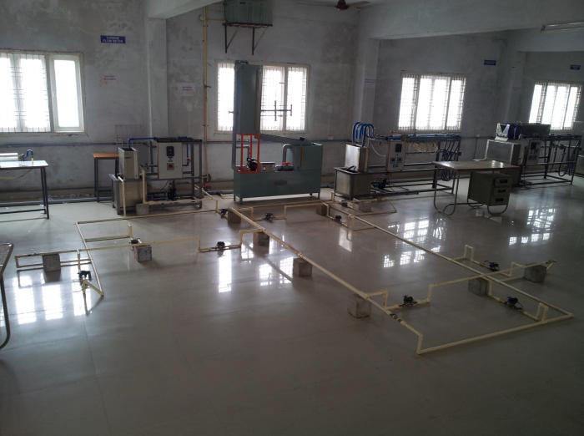
smart meter network constructed in the lab with ten smart meters:
12/21/2018
RRM1

Slide 10
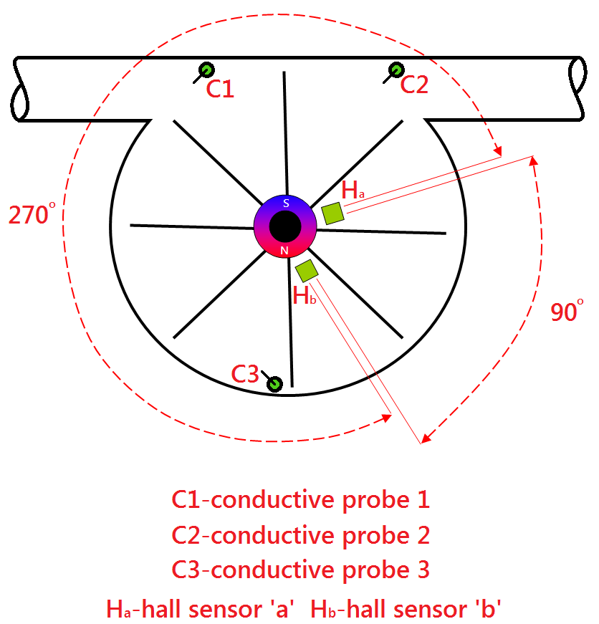
Flow Sensor Construction in Smart Meter:
12/21/2018
RRM1

Slide 11
Working Procedure of Smart Meter:
Circular sealed chamber with tangential inlet and outlets.
A paddle wheel turbine is placed in the chamber such that water flows from inlet to outlet rotating the turbine.
A ring magnet is placed at the center of the turbine. When the turbine rotates, the ring magnet also rotates.
Hall sensor is placed over the sealed chamber near the center of the turbine.
12/21/2018
RRM1

Slide 12
When the turbine rotates, the ring magnet passes under the hall sensor.
Hall sensor produces a high pulse when a magnetic north passes near it and a low pulse when a magnetic south passes near it.
Thus it produces a square wave when the turbine is rotating. The frequency of this square wave is directly proportional to the fluid velocity.
An 8-bit microcontroller in the smart meter counts this pulses from the hall sensor and stores them in its memory. The number of pulses occurred on the sensor output is added to the database for each second.
12/21/2018
RRM1

Slide 13
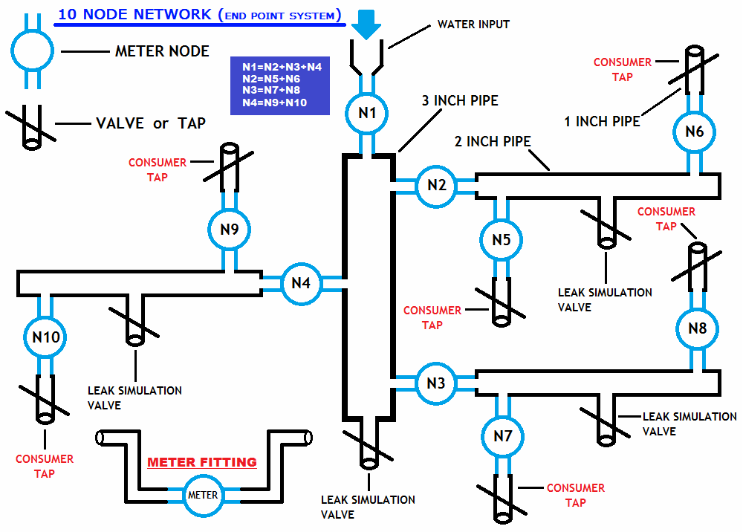
Prototype smart meter network constructed on Test bed in the lab:
12/21/2018
RRM1

Slide 14
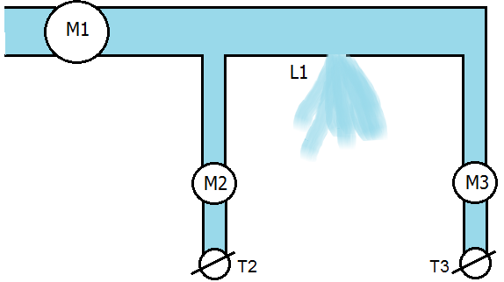
Leak Analysis in water pipes:
Q1,Q2 and Q3 be the flow rates of M1,M2 and M3 respectively. Let L be the leak in the section. Then Q1=Q2+Q3+L1
12/21/2018
RRM1

Slide 15
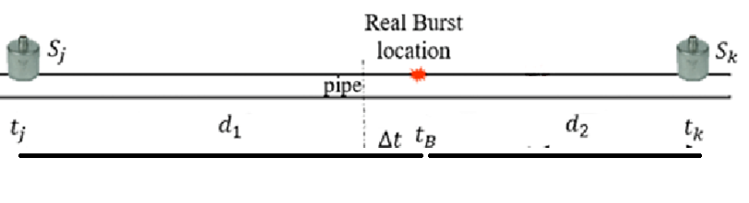
Leakage Position Estimation:
Δt = tj − tk = cross correlation(Sj , Sk )
d1 = 1/ 2 (D + cΔt)
d2 = 1 /2 (D − cΔt). j and k are nodes, D Pipe length, c flow rate, Burst occur time- t_{B}
12/21/2018
RRM1

Slide 16
Vital Attributes in water leakage system:
Smart meter id:
Smart meter IP address:
Pulse rate: sensor generates it.
Flow rare: Depends on Pulse rate.
Quantity: derived from flow rate.
Date & time:
Longitude, latitude & altitude:
Common bandwidth, spread factor etc
12/21/2018
RRM1

Slide 17
Procedure to identify leakage location using smart meter in WDN:
The data set collected from smart meters are not labeled. so we can't apply classification technique directly.
steps:
1) Applying clustering technique on given data set.
2) Two categories are generated. small cluster identified as leak records, other one is non leak records. leak records are class labeled by 1 and non leak records are indicated by 0 as class label.
3) Train CNN (Convolution neural network) on modified data set.(classification technique).
4) CNN model had been trained.
5) classify new data based on trained model to identify leak location, Then we find precision of the model.
12/21/2018
RRM1

Slide 18
Continued.,
6) It will return the leakage record. This record contains smart meter id & other attributes.
7) by using these fields, we can find out location of the smart meter, it indicates that there is a leakage in water pipe line before that smart meter.
8) The leakage size can be predicted, based on D-matrices (information model) using principle of equalence .
9) D-matrices contains entire graph of WDS in the form of adjacency matrix and all the essential attributes of our data set.
10) To identify the exact location of leakage, then apply leakage location
estimation algorithm.
12/21/2018
RRM1

Slide 19
ALGORITHMS Studied:
Clustering Algorithms:
Def: It learns from test data that has not been labeled, unsupervised learning identifies commonalities in the data and reacts based on the presence or absence of such commonalities in each new piece of data.
Classification Algorithms:
Def: It is the machine learning of learning a function that maps an input to an output based on example input-output pairs. It infers a function from labeled training data consisting of a set of training examples.
12/21/2018
RRM1

Slide 20
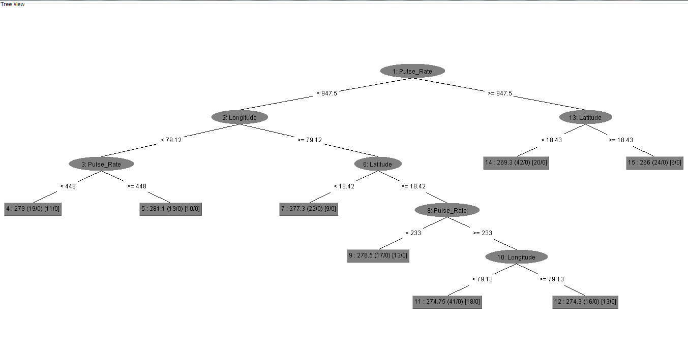
Intermediate Results: (Decision tree)
12/21/2018
RRM1

Slide 21
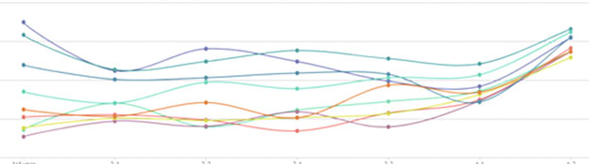
Intermediate Results (SPY-Line):
Time on X-axis & water quantity on Y-axis.
12/21/2018
RRM1

Slide 22
Conclusion :
This model can easily predict leak detection and diagnosis in under ground water pipe line system.
It can estimate pressure in water pipe lines.
Predict the leakage location.
Analyze the leakage size.
Evaluates the water loss from that leakage.
12/21/2018
RRM1

Slide 23
Paper-1: A survey on Leaks and Faults Detection and Diagnosis in Water Supply System:
Different offerings of Faults Detection & Diagnosis techniques are discussed.
look into innovative methods that could make the leak exposure more effective.
Developed schema for datasets, collecting data from thousands of hall sensors, organization of these big data sets.
The aspects and the problems raised during the data set mining are focused.
12/21/2018
RRM1

Slide 24
Paper-II: An Optimal Heuristic for Student Failure Detection and Diagnosis in the Sathvahana Educational Community Using WEKA:
Explore students characteristics and to determine unsuccessful student groups, based on their earlier education and other factors.
Predictive classification technique applied in the finding of not winning samples.
The method adopted, To know the number of students failure in each subject and analyze the reasons for failure.
12/21/2018
RRM1

Slide 25
References
[1] Thorsten Schuetze and Vicente Santiago, “Quantitative Assessment of Water Use Efficiency in Urban and Domestic Buildings” Published: 6 August 2013, ISSN 2073-4441 in mpdi water journal.
[2] V Tornero, GeorgHanke, “Chemical contaminants entering the marine environment from sea-based sources: A review with a focus on European seas”, elsevier,Volume 112, Issues 1–2, 15 Nov 2016.
[3] Michael Allen, Mudasser Iqbal, Lewis Girod, Ami Preis, Seshan Srirangarajan,Cheng Fu, Kai Juan Wong, Hock Beng Lim, AndrewWhittle, “WaterWiSe@SG: a WSN for Continuous Monitoring of Water Distribution Systems”.
[4] Rachel Cardell-Oliver, Verity Scott, Tom Chapman “Designing sensor networks for leak detection in water pipeline systems” published in ISSNIP, 2015 IEEE Tenth International Conference.
[5] Smart meters for enhanced water supply network modeling and infrastructure planning by Thulo Ram Gurunga, Rodney A. Stewartb,, Ashok K and Sharmac, 2014 Elsevier.
[6] H.J. Convey and M.J. Booth, “Development of a water leak detection system”, Computing & Control Engineering Journal, Volume: 13, Issue: 1, Feb. 2002.
[7] Dr. R V R K CHALAM, J.RAVI TEJA, ITRA Research, “Self Powered Smart Water Meter for Water Quantity Metering of Water Supply Distribution Networks”, at media lab asia.
[8] The Potential Future Innovative Application of Municipal Water Supply Database by Thewodros G. Mamo, Ilan Juran.
[9] A methodology of leakage detection and location in water distribution networks — The case study By Wojciech Moczulski
[10] Characterization of an acoustic wireless sensor for water leakage detection in underground pipes By Abdullah Kadri.
[11] Water Supply Database”. International Journal of Scientific Engineering and Research (IJSER). www.ijser.in,ISSN 2347-3878,Volume 2 Issue 3, March 2014.
[12] Anshul Bansal, Susheel Kaushik Rompikuntla, Jaganadh Gopinadhan, Amanpreet Kaur, Zahoor Ahamed Kazi “Energy Consumption Forecasting for Smart Meters”.

Slide 26
References Continued..
[13] Andrea Cataldo, “A New Method for Detecting Leaks in Underground Water Pipelines”, IEEE 2016, Volume 2.
[14] Milind Naphade,IBM Research “Smart Water Pilot Study Report”, City of Dubuque.
[15] Cortez P, Silva A (2008) Using data mining to predict secondary school student performance.In: Brito A, Teixeira J (eds) Proceedings of 5th future business technology conference (FUBUTEC 2008) pp 5–12, Porto, Portugal, April, 2008, EUROSIS, ISBN 978-9077381-39-7
[16] Hearst T (1999) Untangling text data mining. In: Proceedings of the 37th annual meeting associative computer. Linguist, 1999, pp 3–10
[17] Estimating profile of successful IT student: data mining approach by Dijana Oreški University of Zagreb
[18] Predictive modeling of the first year evaluation based on demographics data: case study students of Telkom University, Indonesia, Tora F, Joko LB (eds.) In: 2016 international conference on data and software engineering (ICoDSE)
[19] Venkatasubramanian V, Rengaswamy R, Yin K, Kavuri S (2003) A review of process fault detection and diagnosis Part III: process history based methods. Comput Chem Eng 27 (3):327–346
[20] Gruber TR (1993) A translation approach to portable ontology specifications. Know Acq 5 (2):199–220
[21] Benedittini O, Baines TS, Lightfoot HW, Greenough RM (2009) State-of- the-art in integrated vehicle health management. J Aer Eng 223(2):157–170
[22] Vasanth Sena P (2013) Presented a paper on, “A survey on finding frequent items in text by various heuristic data structures” at National conference on advances in computing & networking (NCACN-13) JNTU Manthini, Karimnagar, Telenagana, India on 7 Dec 2013.
[23] Vasanth Sena P, Ramesh P (2013) Induction decision trees for tentative data. Int J Comp Sci Manag Res 2(10)
[24] Vasanth Sena P (2013) Published a paper on 29th July 2013 on “An approach finding frequent items in text or transactional data base by using BST to improve the efficiency of apriori algorithm” at Cornell University Library On arXiv:1307.7513v1 [cs.DB]

Slide 27

Queries

Slide 28
Thank You for Listening

Slide 29
Humble Request
To Change the Research Title
Actual Title
An Ontology based Text Mining Frame work for efficient Fault Detection and Diagnosis using heterogeneous Graph based D-Matrices.

Slide 30
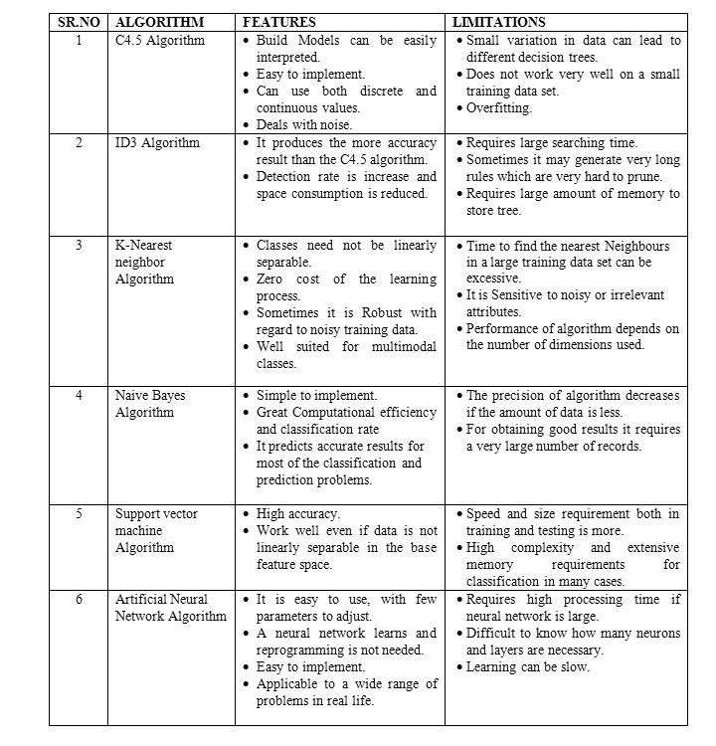
Classification Techniques:
12/21/2018
RRM1

Slide 31
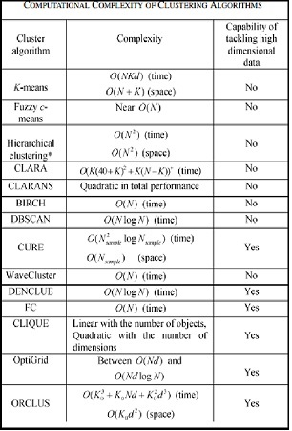
Clustering Techniques:
12/21/2018
RRM1

